Slide 1
Autonomous Physics-Based Modeling of Retention Loss in 3-D NAND Flash Memory in Cryogenic condition EDL Manuscript Change & Progress Myung Jin

Slide 2
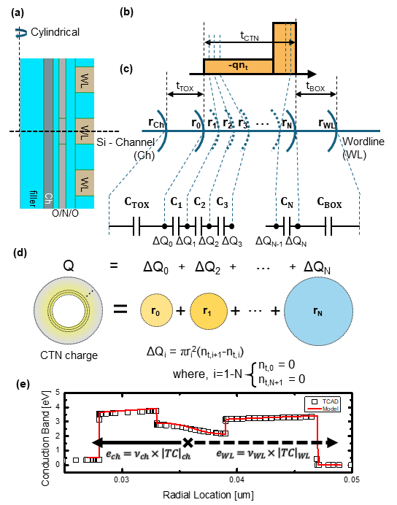
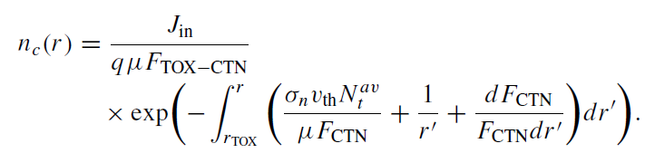
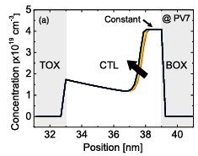
Detailed Poisson Solution
Fig. 1
IEEE T-ED 71 (2024) 2386–2392
JJAP 65 (2026) 011004
(b) pgm charge
Charge distribution model adapted
최해찬/유진일 TED 2024
이찬 JJAP 2026

Slide 3
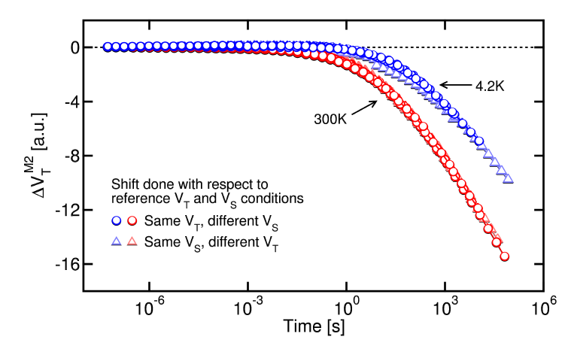
Cryogenic and Detrapping
Measurement (Refaldi, IRPS 2025)
Cryogenic condition (~ 4.2K) : physical separation of detrapping effect
Separation of detrapping effect measurement
**Time is in not in A.U. : calibration of time constant can be done

Slide 4
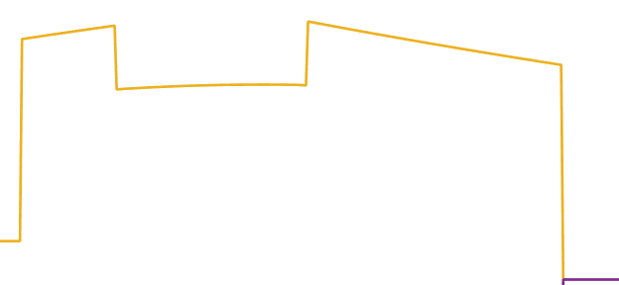

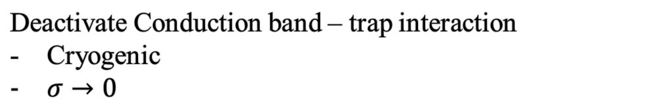
Cryogenic and Detrapping
Deactivate Conduction band – trap interaction
Cryogenic
$σ→0$
Measurement calibration result:
Used scale
O/N/O = 3/6/8 [nm]
(cf. DRL spec: 5/6/8 [nm])

Slide 5
Autonomous Modeling & Result
TCAD – model Matching
TOX variation
3/3.5/4/4.5/5 [nm]
Well match with TCAD - model

Slide 6
Progress with paper
Done progress
Measurement calibration figure added
TCAD-model matching figure added
On-going progress
Benchmark information
Referencing

